Slide 1

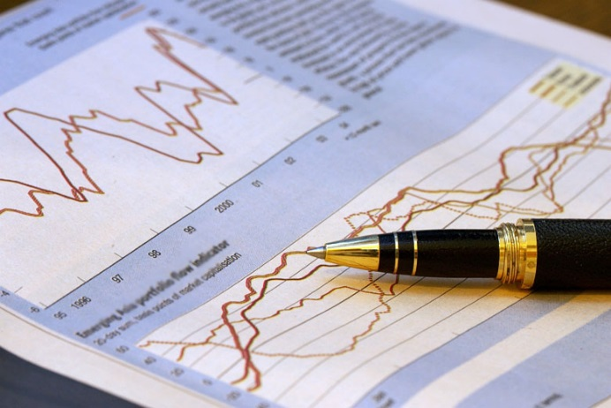


MBC 638: Data Analysis & Decision Making
Anna Chernobai
Lecture 01:
Introduction

Slide 2
Today’s lecture:
1. First, I will tell you about myself.
2. Then, we’ll talk about you.
3. Course logistics.
4. Why statistics?

Slide 3
MBC638: Course Logistics
Instructor:
Prof. Anna Chernobai
Office: WSM 609
Phone: (315) 443-3357 (office)
E-mail: annac@syr.edu
Office Hours: MW 1:30pm-2:30pm
or by appointment

Slide 4
MBC638: Course Logistics
What you will learn in this class:
Statistics is the study of data analysis
+
Management science is the study of model building, optimization, and decision making
=
Data analysis and decision making

Slide 5
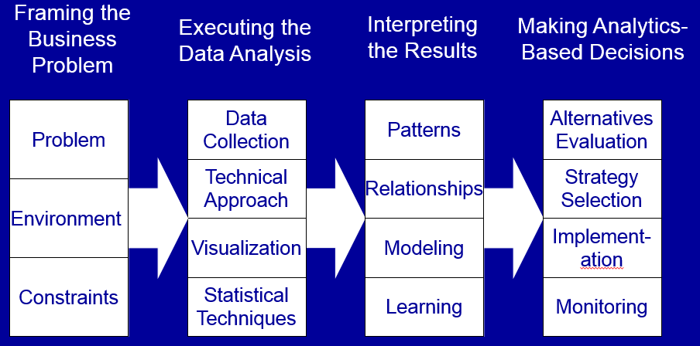
MBC638: Course Logistics
This course will prepare you for many other courses, including the Business Analytics (SCM 600) course that you can take next semester.
Scope of the SCM 600 course (Prof. Don Harter, Lecture 01):
Scope of MBC 638

Slide 6
MBC638: Course Logistics
Topics:
Data description and visualization
Regression analysis (OLS, Logistic)
Probability
Population mean and variance; weighted sums
Normal distribution
Sampling and Central Limit Theorem
Confidence intervals
Hypothesis testing
Time series modeling and forecasting
Other special topics (e.g., Monte Carlo simulation, advanced data analytics techniques) if time permits

Slide 7
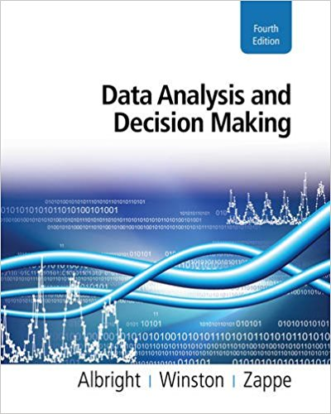
MBC638: Course Logistics
Textbook:
Data Analysis and Decision Making
Albright, Winston, Zappe
4th edition, 2011.
Newer editions O’K to use too.

Slide 8
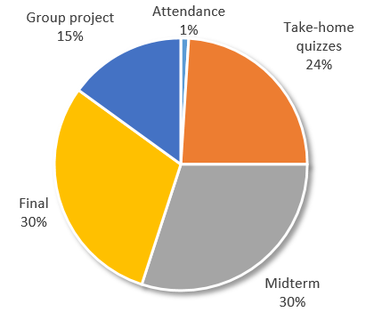
MBC638: Performance assessment
Due December 7, Thursday
Written project (5 pages)
4-5 students per team
Each student will fill out peer review form after completing the project
Mandatory
Taken every class
Weekly
Approx. 30-45 mins
Individual work
Lowest 2 scores dropped
Many require Excel
During exam week
Excel + written
October 17, Monday
Excel + written
Grade: MT adjusted = 0.5*MT+ 0.5*max{MT, FINAL}

Slide 9
Final Grade Distribution
No more than 35% of A and A-.

Slide 10
Whitman standards
Classroom policy
No laptops or cell phones are permitted during lectures unless instructed otherwise
No food or drink except water
Group projects should be professional quality
Active participation in class is required
Studying in groups outside of the classroom is encouraged

Slide 11
Today’s lecture:
1. First, I will tell you about myself.
2. Then, we’ll talk about you.
3. Course logistics.
4. Why statistics?

Slide 12

Statistics in business
We are living in the age of data and technology.
Technology has given firms and people the power to analyze data and make decisions on the basis of quantitative analysis.
A large amount of data already exists and will only increase in the future.
Enlightened companies are seeing this expansion as a source of competitive advantage. By using quantitative methods to uncover the information in the data and then acting on this information, they are able to gain advantages that their less enlightened competitors aren’t able to gain.

Slide 13

Statistics in business
The financial industry:
The financial industry has been the top IT-intensive industry in the U.S. since the 1990s.
Growth in use of IT has been a key contributor to the industry’s large productivity gains.
Of course, there are also some costs. For example, software bugs cost the financial industry $3.3 billion annually due to temporary shutdowns, lost transactions, and delays in transaction processing. In recent years, IT-intensive industries have been subject to strong regulations.

Slide 14
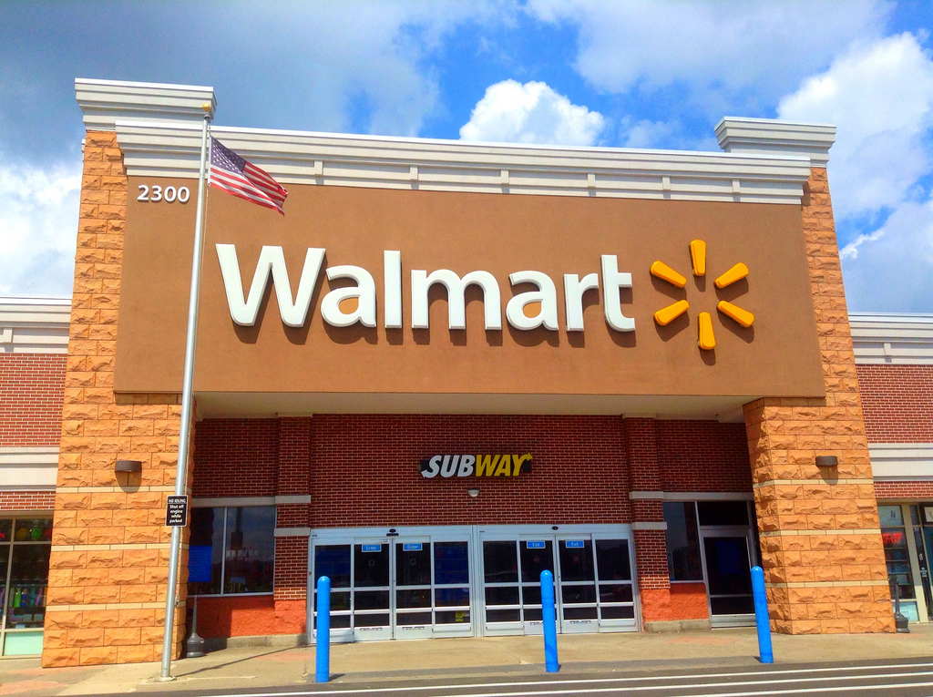

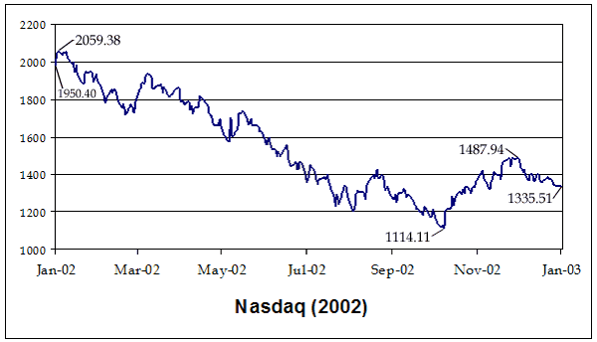



Statistics in business
Retailers collect point-of-sale data on products and customers when transaction occurs.
Credit agencies collect data on individuals wishing to obtain credit to determine their creditworthiness and probability of default.
Investors collect data on historical performance of stocks and bonds.
Government agencies collect data on economic trends.
Insurance companies analyze historic claims data to determine the
premium amounts.
Online advertisers collect data on the background of visitors to
different websites, in order to tailor different ads to
different people.

Slide 15
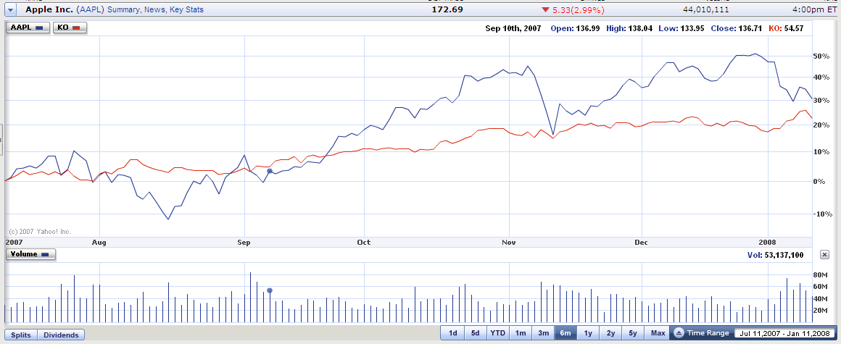
Applications of statistics in business
Finance
Apple
Coca-Cola
Which of the two stocks would you invest in?

Slide 16

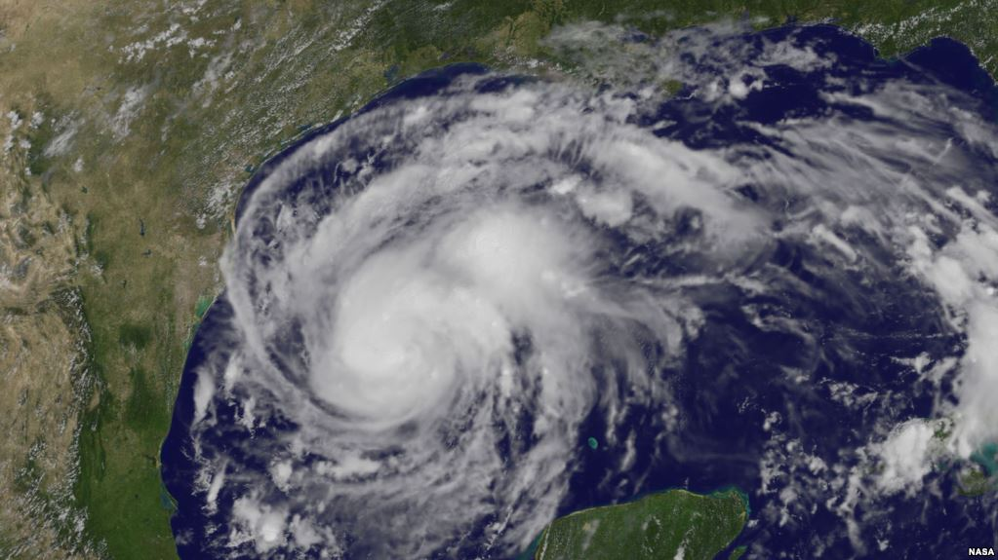

Applications of statistics in business
Insurance
Hurricane Harvey
August 2017
How is insurance premium determined?
What are the expected losses to an insurance company in an event of a flood?
Are insurance claims independent from each other? Are claim sizes correlated? Your insurance premium would be higher if claims are correlated – why?

Slide 17

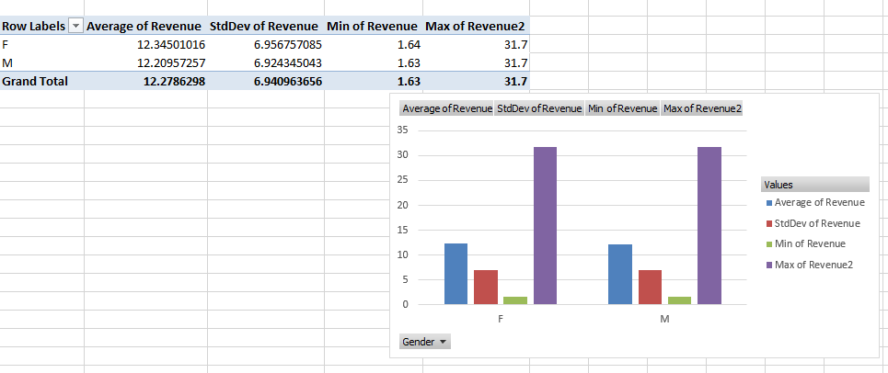
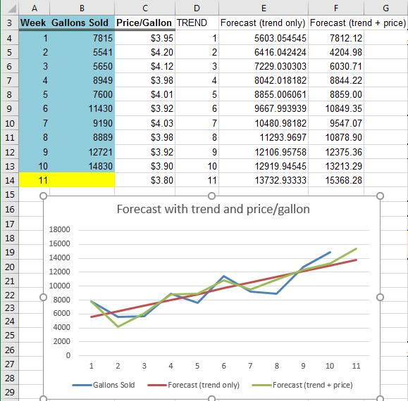
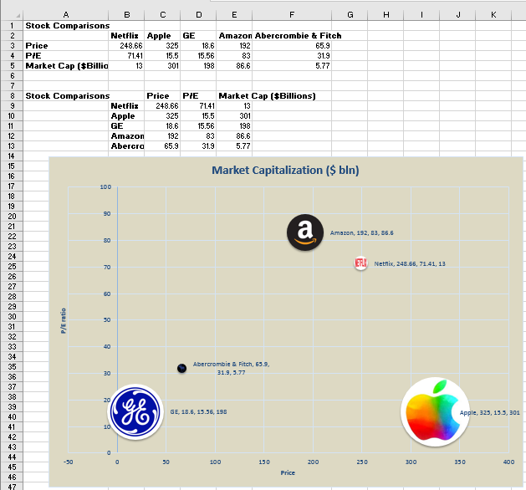
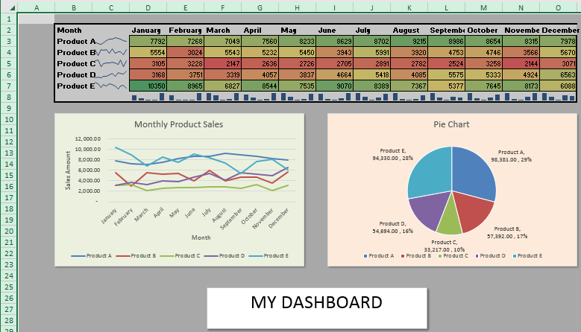
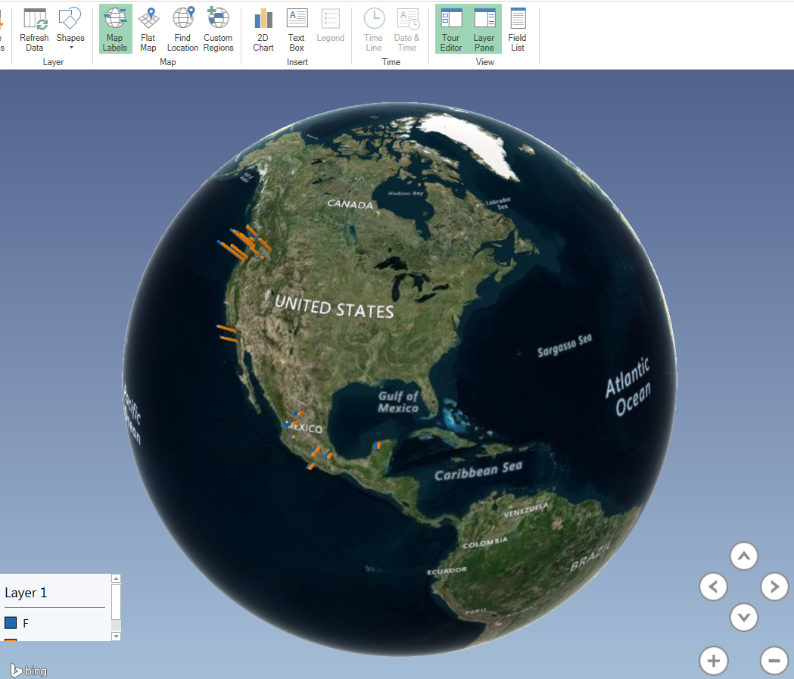
Excel
In this class, we will use a lot of Excel.
We will also use Palisade’s StatTools add-in for Excel. It is available on all computers at Whitman. You can also access it remotely from home.

Slide 18

The importance of Excel in business
Fortune, April 17, 2013:
“Damn Excel! How the ‘Most Important Software Application of All Time’ Is Ruining the World”
The popular Microsoft program has been implicated in the financial crisis, Europe's growth problems, the U.S.'s weak economic recovery, and pretty much everything else.
Apparently some really smart people have trouble mastering Microsoft Office.
Early Wednesday morning, in an e-mail that went out to reporters around 2 A.M., Harvard professors Carmen Reinhart and Kenneth Rogoff copped to making an Excel error in their research paper tying high levels of government debt to low levels of growth. The paper, "Growth in Time of Debt," has become a powerful data point for those who argue against government spending even to revive the economy -- Congressman Paul Ryan cited it in his most recent budget -- and is the basis for the two professors' best-selling book This Time is Different.

Slide 19
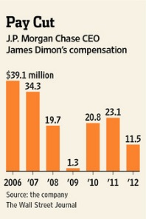
The importance of Excel in business
London Whale.
In the wake of last year's $6.2 billion JPMorgan Chase (JPM) trading loss, traders have been fired, top executives have been hauled in front of Congress, and the FBI, among other regulators, is investigating. But you know who really needs to be questioned? Bill Gates. According to an internal report on the trading loss released in February, the model that was supposed to monitor and limit the amount of risk the bank's London traders were taking was "operated through a series of Excel spreadsheets, which had to be completed manually, by a process of copying and pasting data from one spreadsheet to another." One key measure was added when it should have been averaged. The result: Risk officers at JPMorgan believed the credit derivatives bets were half as risky as they actually were. So, I guess, CEO Jamie Dimon can pass $3.1 billion off on Excel. The rest is still on him.

Slide 20
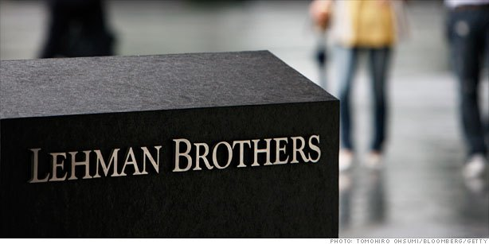
The importance of Excel in business
Barclays purchase of Lehman Brothers.
When Barclays sent over its offer to buy up Lehman Brothers in the immediate wake of the firm's September 2008 collapse, it did so with an Excel spreadsheet. The makers of the spreadsheet, which detailed Lehman's assets and what Barclays was willing to buy, hid, rather than deleted, nearly 200 cells. But when a junior law associate at Cleary Gottlieb Steen & Hamilton converted the Excel file to a PDF and e-mailed it over to the bankruptcy court, the hidden parts of the spreadsheet reappeared. The result: Along with the parts of Lehman Barclays wanted, the British bank was also forced to swallow losses on an additional 179 toxic deals it never intended to buy.

Slide 21
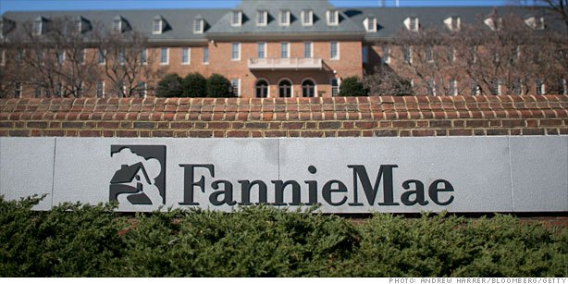
The importance of Excel in business
Fannie Mae.
We should have seen the financial crisis coming. Back in 2003, the giant mortgage guarantor made an error in an Excel spreadsheet when transitioning to a new accounting regulation. The result: an error that made Fannie look $1.3 billion more profitable than it actually was. The company was forced to later restate its results.

Slide 22
MBC 638
Questions?
Concerns?
Comments?

